Slide 1
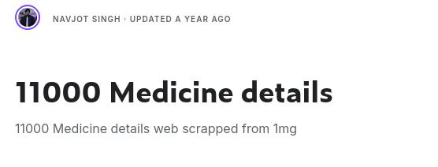


What, Where, and Why?
There are many medications
Too many for any one person to memorize and use effectively
Some medications share similar uses, composition, or side effects
This project aims to provide a way to browse a list of medication and compare them to other similar medications
The dataset provides review, composition, side effects, and usage for 11500 medications

Slide 2
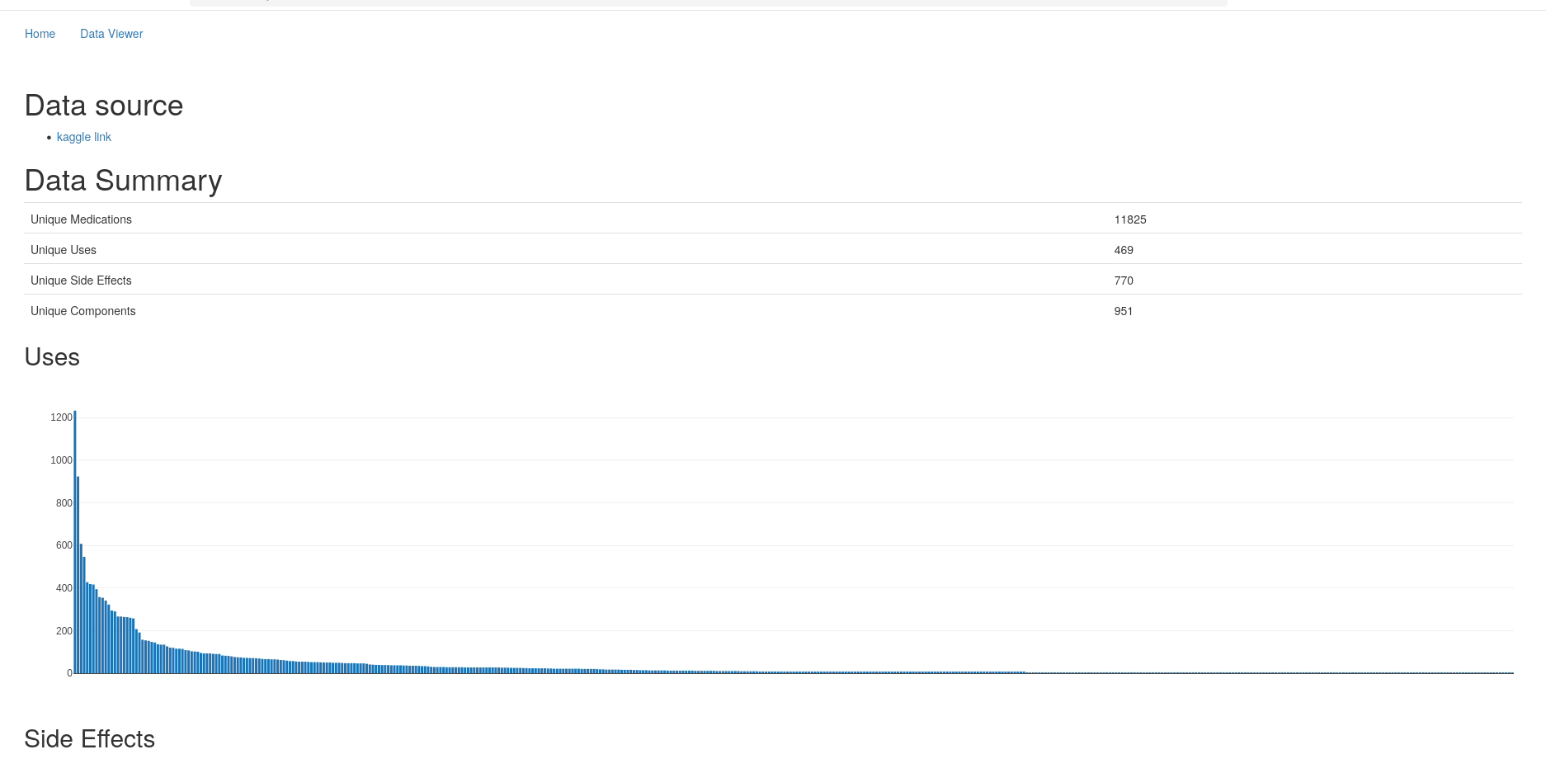
https://illustratedman-code.shinyapps.io/project/

Slide 3
The End?
Anecdotally, medications that shared one similar trait (i.e. composition), had another similar trait (i.e. usage)
May be useful for physicians when selecting alternative medications for their patients
Some medications have better reviews than others even if they have similar uses/compositions
The dataset was limited in scope (few variables) and origin of review data is unclear
Better distance variable could be computed using NLP techniques

